Slide 1
SlicerIGT tutorial 2017
Offline software installation

Slide 2
Install Slicer offline
If you have already installed
Slicer 4.8 or later version
AND SlicerIGT and SlicerDMRI extensions
AND downloaded the tutorial data
then you do not need to follow the next slides

Slide 3
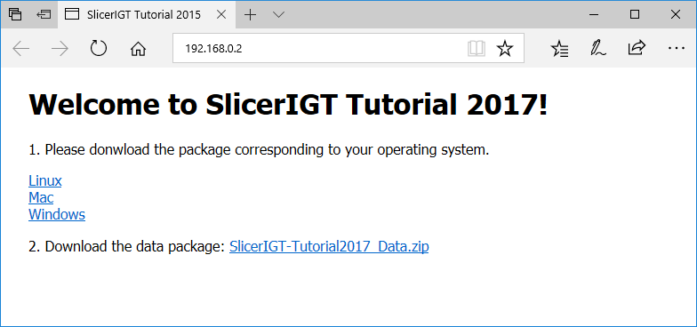
Connect to the tutorial WiFi
Connect to SlicerIGT2 WiFi
(or SlicerIGT1, but that is slower)
  Password: slicerigt
There will be no internet, just local network
Visit this address in your web browser: 192.168.0.2

Slide 4
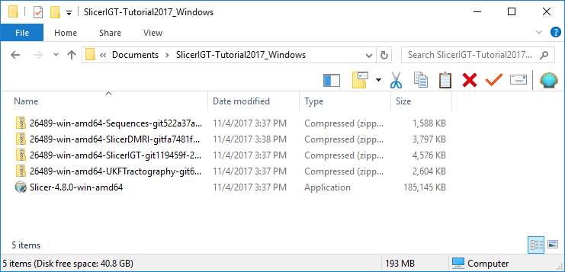
Download and install 3D Slicer
Download the tutorial data package and extract it in your home folder or Desktop folder
Download the installer package corresponding to your operating system and extract that too
Run the extracted Slicer installer executable
  E.g. Slicer-4.7.0-2017-09-06-win-amd64.exe
Run

Slide 5
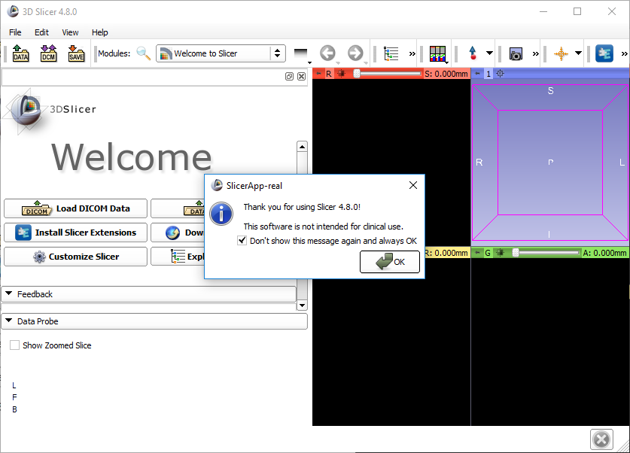
1
2

Slide 6
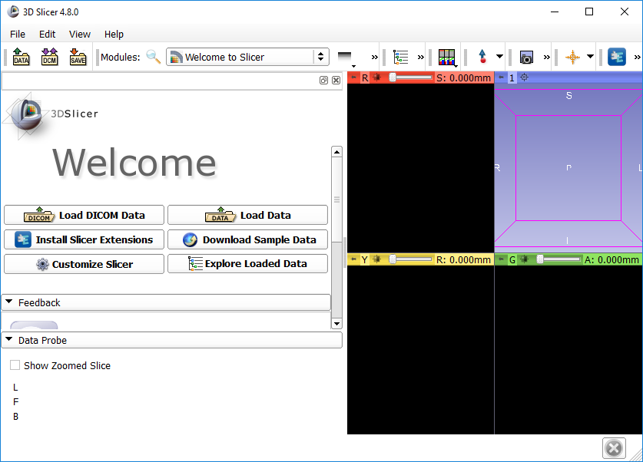
1

Slide 7
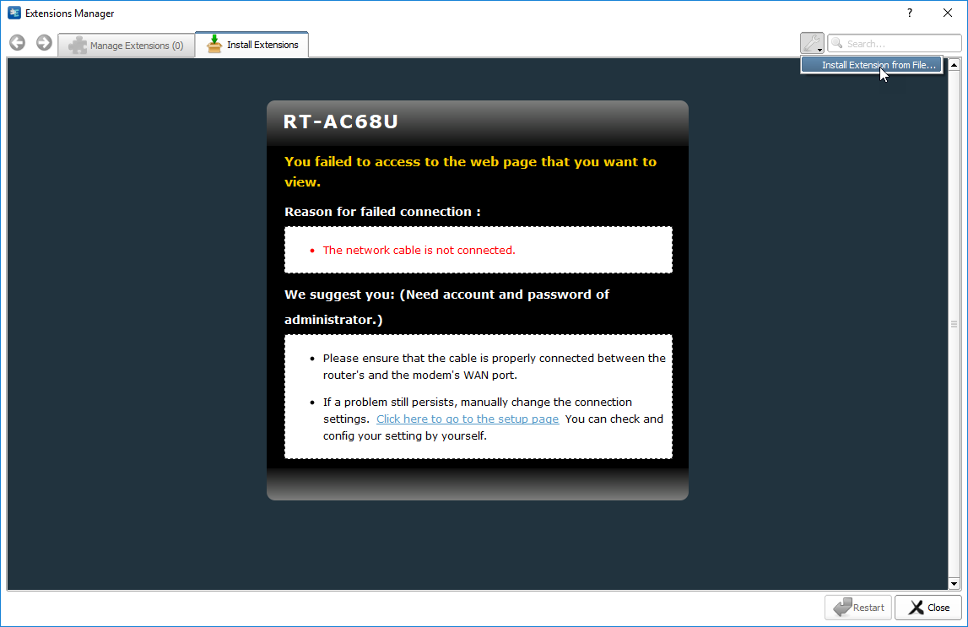

Slide 8
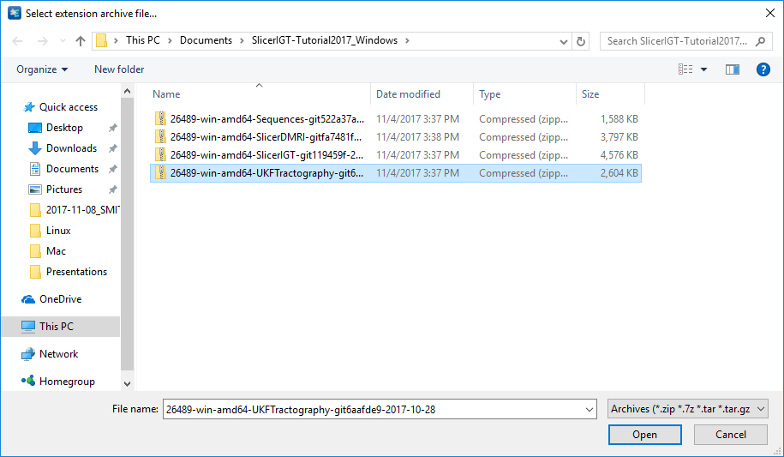
1
2

Slide 9
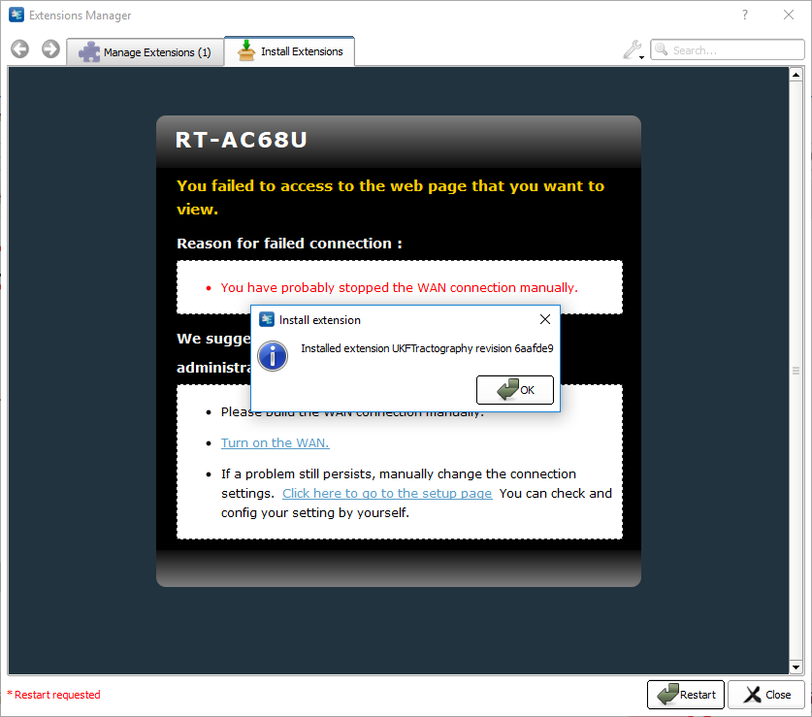
click

Slide 10
Repeat this to install the other extensions

Slide 11
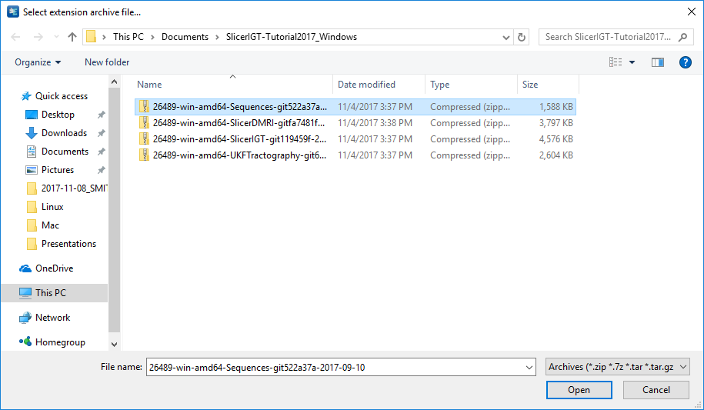
1
2

Slide 12
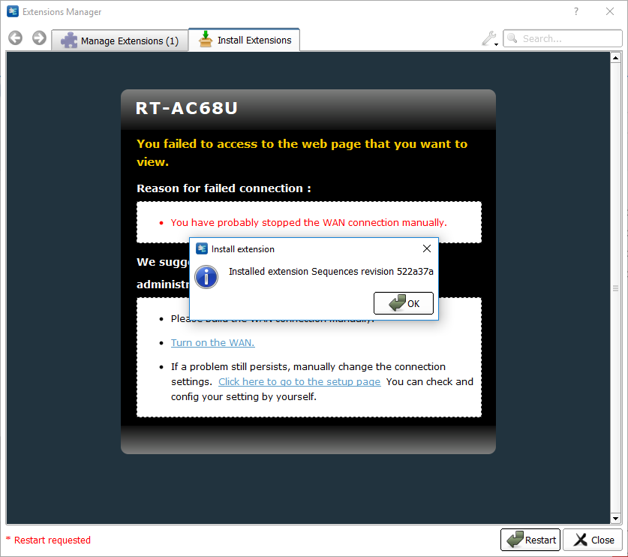
click

Slide 13
Repeat this to install the other extensions

Slide 14
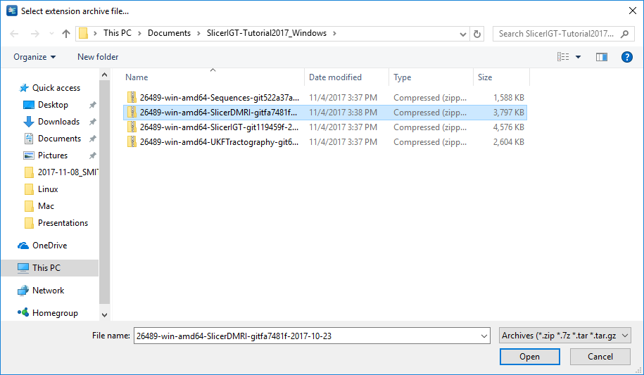
1
2

Slide 15
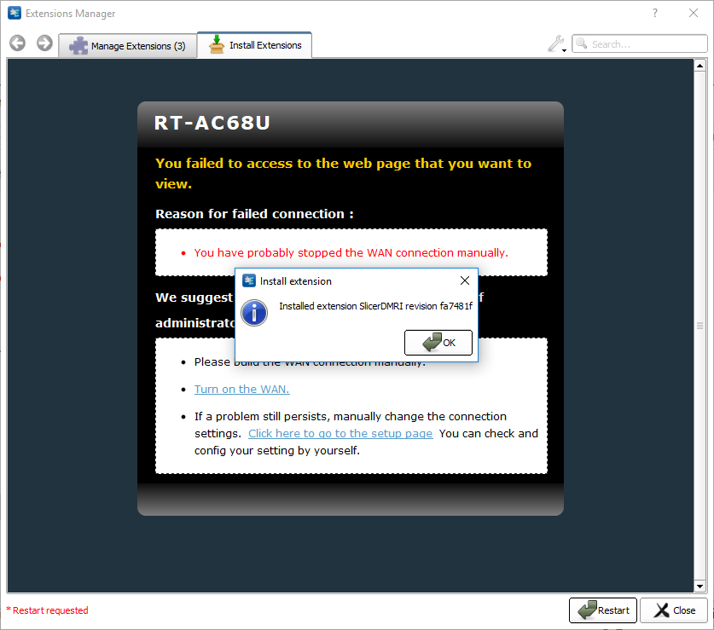
1

Slide 16
Repeat this to install the other extensions

Slide 17
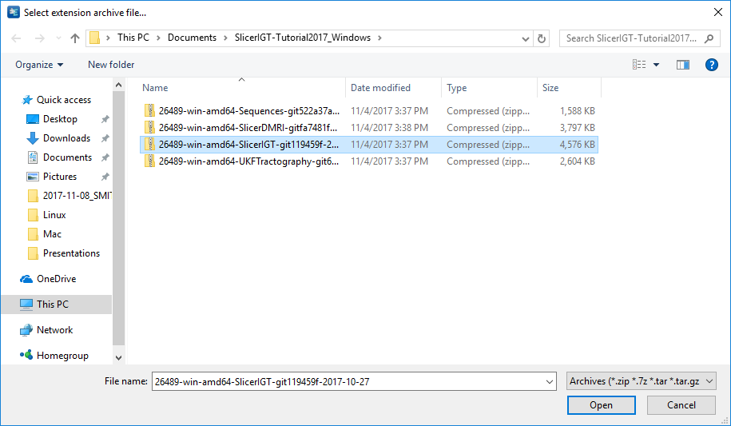
1
2

Slide 18
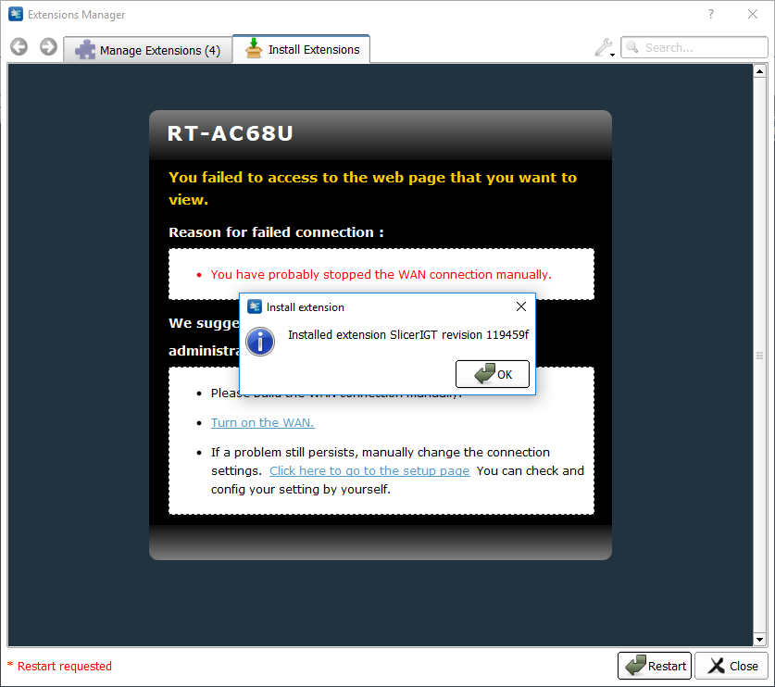
1
2

Slide 19
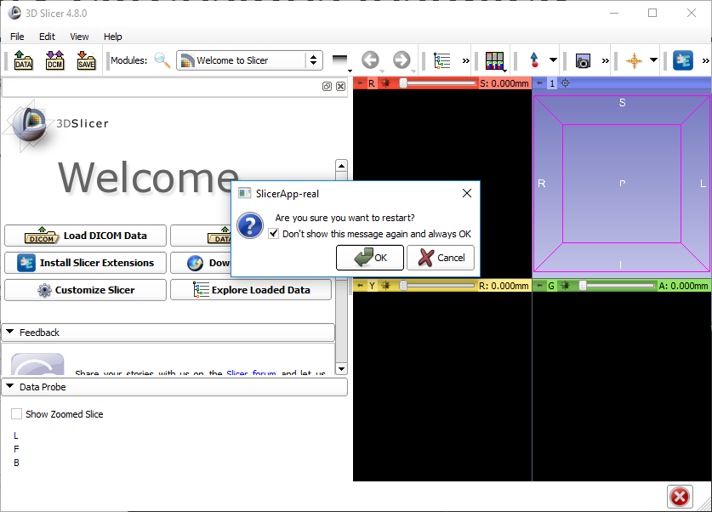
1
2

Slide 20
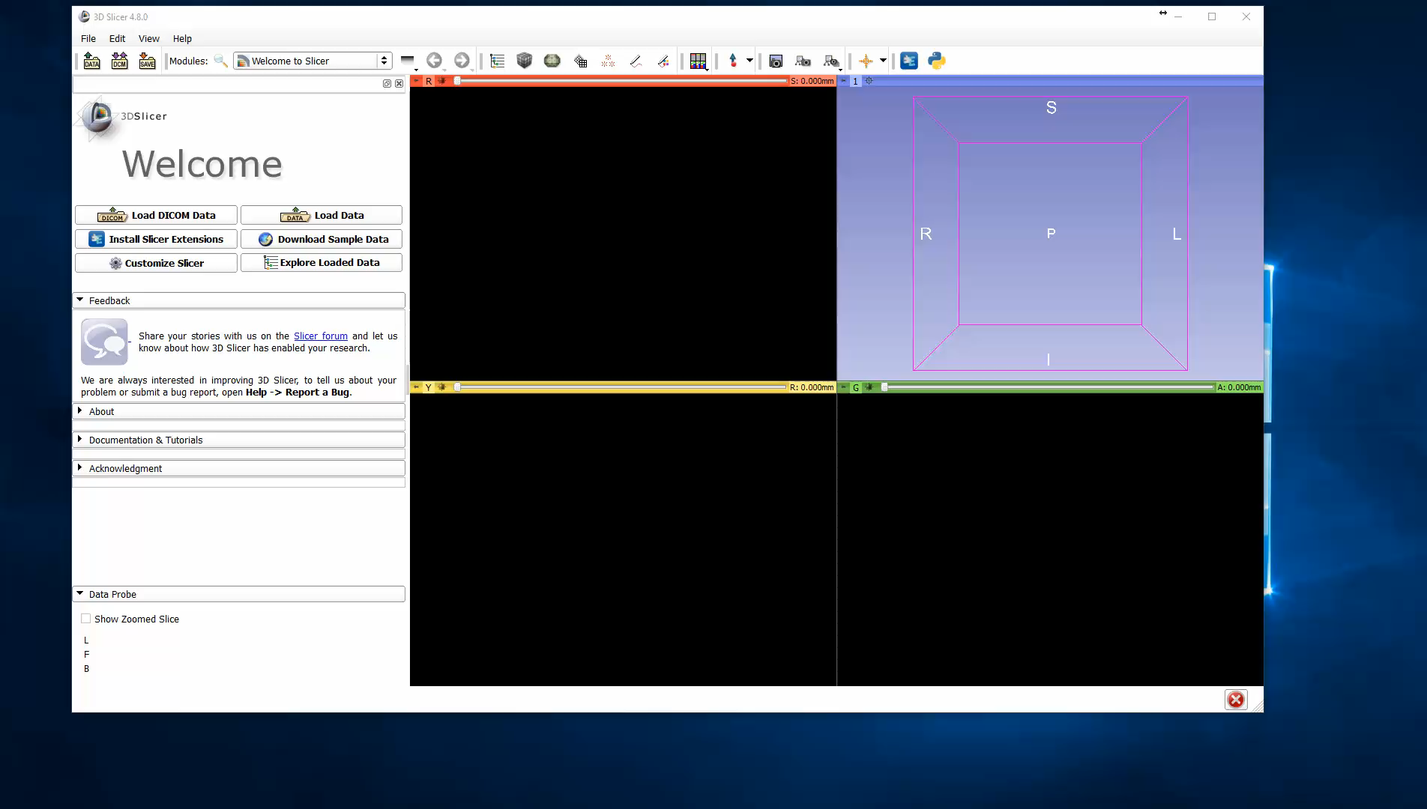
Verify extra modules installed

